Slide 1


ISC Consulting Group
Capabilities and Experience
Twenty years of mission delivery for federal and Department of War customers, from concept to capability.
Clint Imholte
Chief Executive Officer
520-678-8778 | Clint.imholte33@isc-cg.com
Danielle Downing
Senior Vice President
520-255-0968 | Danielle.downing@isc-cg.com
Integrity · Service · Commitment
502 N. Garden Avenue, Suite M4a, Sierra Vista, AZ 85635 | www.isc-cg.com

Slide 2
WHO WE ARE
A small business built for mission critical work
ISC Consulting Group delivers program management, information technology, cybersecurity, engineering, and the integration, deployment and operation of information systems that support network centric operations.
Mission
To be a leading provider of value-added services built on quality people, impeccable client satisfaction and enabling better decision making.
20+
90%
15 yrs
Vision
To be a leader in the market for operational services with an impeccable record for customer mission success, where our employees excel at what they do.
years serving federal and DoD customers
of staff hold security clearances
average staff experience
Small business, NAICS 541611 primary. Headquartered in Sierra Vista, Arizona.
Contract posture. 20 years experience as a prime contractor; OCI free and unbiased.
Growth platform. Ten-year GSA renewal and a newly formed 8(a) joint venture.
Core Values
Integrity · Service · Commitment
2
502 N. Garden Avenue, Suite M4a, Sierra Vista, AZ 85635 | www.isc-cg.com

Slide 3

GSA Contract
Experienced GSA Provider
Contract#: GS-02F-0222X Multiple Award Schedule (MAS)
Socio-Economic: Small Business, Service-Disabled Veteran Owned Small Business, SBA Certified HUBZone Firm
SAM UEI: JK2HX2ULLHK3
NAICS: 541611
Current Option Period End Date: August 3, 2031
Government Point of Contact:
Janice Hartley-rodriques
212-264-8732
janice.hartley-rodriques@gsa.gov
GSA eLibrary: https://www.gsaelibrary.gsa.gov/ElibMain/home.do/pdf/pdf/contractorInfo.do?contractNumber=GS-02F-0222X&contractorName=ISC+CONSULTING+GROUP%2C+INC.&executeQuery=YES
2
502 N. Garden Avenue, Suite M4a, Sierra Vista, AZ 85635 | www.isc-cg.com

Slide 4
COMPANY HISTORY
Twenty years of steady, deliberate growth
2006
2009
2013
2017
2021
2026
ISC founded
TS facility clearance; HUBZone designation
Expansion into cyber; Georgia office; 65 employees
NPS prime IDIQ; expansion into IMI and T&E; VA certified SDVOSB
8(a) JV formed; JV prime contract
GSA renewal for 10 years; ISC turns 20
2007
2011
2015
2019
2023
GSA Schedule awarded; 25 employees
Arizona Small Business of the Year; offices in Texas and Nevada
International JV and office in Saudi Arabia; growth to 100
Key full and open competition wins
Prime expansion for Army and Air Force; growth to 150
From a single office in Sierra Vista to prime contracts for the Army, Air Force, National Park Service and GSA, with international and domestic joint ventures along the way.
3
502 N. Garden Avenue, Suite M4a, Sierra Vista, AZ 85635 | www.isc-cg.com

Slide 5
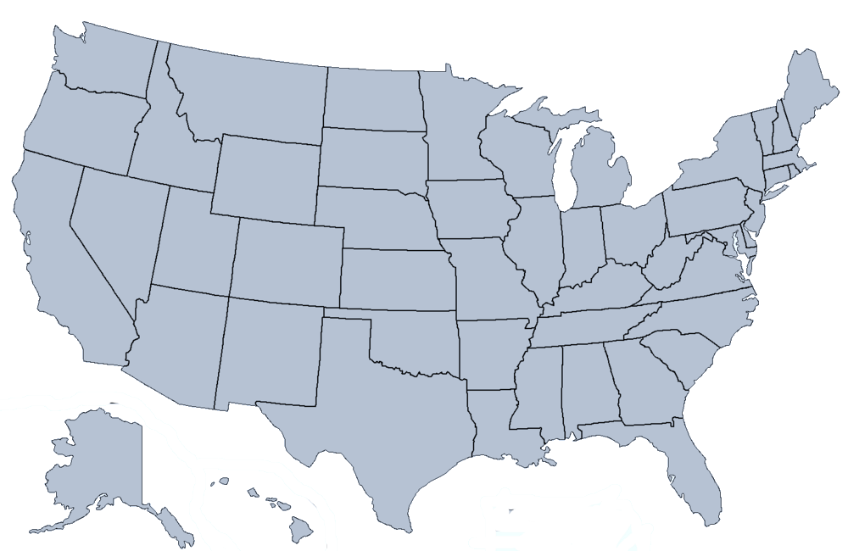
HISTORICAL WORK SITES
Where we have delivered
Fort Huachuca, AZ
Fort Belvoir, VA
Fort Leavenworth, KS
Washington, DC
Honolulu, HI
San Diego, CA
Augusta, GA
Boston, MA
Las Vegas, NV
Albuquerque, NM
Austin, TX
Fullerton, CA
Twelve sites across the CONUS and OCONUS theatres, experienced provider of services
4
502 N. Garden Avenue, Suite M4a, Sierra Vista, AZ 85635 | www.isc-cg.com

Slide 6
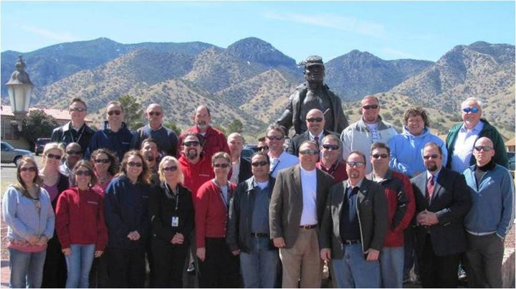
OUR PEOPLE
Educated, experienced and here to stay
~50%
90%
hold advanced degrees; the vast majority hold technical degrees
hold security clearances
15 yrs
High
average professional experience
retention, well above industry norms
Recruited from system developers, government and academia. ISC's culture values customer performance, technical excellence, integrity, service, commitment and teamwork.
5
502 N. Garden Avenue, Suite M4a, Sierra Vista, AZ 85635 | www.isc-cg.com

Slide 7
CAPABILITY AREAS
Six capability areas, one standard of expertise
1
Instructional Solutions
2
Intelligence, Surveillance and Reconnaissance
3
Information Technology
Training requirements through delivery, in T2COM format, by domain experts.
HUMINT training, intelligence systems life cycle support and ISR synchronization & integration.
Enterprise operations and cybersecurity on NIPRNET, SIPRNET and JWICS.
4
Test and Evaluation
5
Systems Engineering and Integration
6
Artificial Intelligence
Support the acquisition process through IOT&E, LUT, and DT with expert program analysis.
Requirements, acquisition and mission engineering across the DOTMLPF-P domains and the programs lifecycle.
AI readiness aligned to the Department of War AI Strategy, with in house secure and agentic AI expertise.
ISC provides in depth, unbiased capability area and domain expertise through our staff of engineers, analysts and technicians.
6
502 N. Garden Avenue, Suite M4a, Sierra Vista, AZ 85635 | www.isc-cg.com

Slide 8
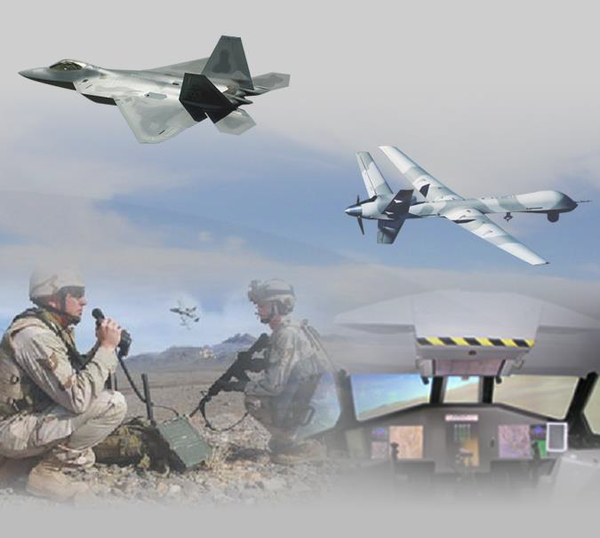
INSTRUCTIONAL SOLUTIONS
Training built by the people who know the mission
Training development and delivery by domain experts
Training System Requirements Analysis (TSRA)
Instructional Systems Development (ISD)
Automated System Approach to Training (ASAT)
Experts in Army T2COM format
Syllabus and training products
Automated computer-based training development
Classroom and computer-based delivery
Hands on equipment and software training
Training requirements through Government approval
Analyze training requirements, identify what is critical and recommend the best technical approach
Design, develop and evaluate strategies, plans and products for individual and collective training
Prepare initial training materiel and acquisition documentation for Government approval
Support leadership in reviewing modernization and acquisition training strategy for new capabilities
7
502 N. Garden Avenue, Suite M4a, Sierra Vista, AZ 85635 | www.isc-cg.com

Slide 9
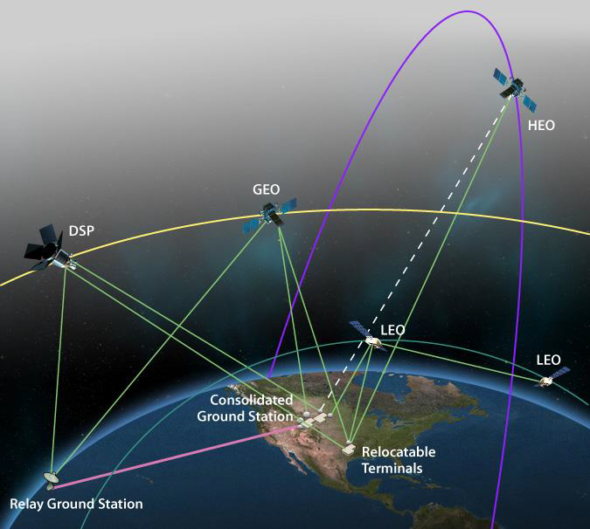
INTELLIGENCE, SURVEILLANCE AND RECONNAISSANCE
Intelligence training and systems support at joint scale
Joint HUMINT training. Supported the HT-JCoE mission with advanced, experiential Joint HUMINT training, professional development, and certification in overt strategic debriefing, Category 1 and 2 Military Source Operations, interrogation, and enabling support, meeting Defense HUMINT Enterprise requirements.
Life cycle training for intelligence systems. Doctrine and Tactics Training and New Equipment Training as an integral part of intelligence system support, plus training for individual professional development.
Requirements into objectives. Facilitated systems and training program requirements definition, translating requirements into discrete, attainable objectives scheduled to fielding and implementation dates.
Intelligence Warfighter Function. Technical support to educate and develop disciplined and competent Intelligence Warfighters, enabling them to integrate MI systems capabilities to ensure the Army can win on any battlefield.
ISR synchronization. Target, vulnerability, and risk identification, monitoring, and analysis for the ISR Synchronization and Information Collection program.
Working knowledge of the functional intelligence areas, applied from the schoolhouse to the Intelligence Enterprise across all domains and the joint force.
8
502 N. Garden Avenue, Suite M4a, Sierra Vista, AZ 85635 | www.isc-cg.com

Slide 10
INFORMATION TECHNOLOGY
Enterprise IT and cyber at three classification levels
ISC provides IT services on NIPRNET, SIPRNET and JWICS: cyber security, the Cyber Virtual Training Network, operations, IT project management, IT procurement and the enterprise service desk.
90%+
15,000+
320+
9,500+
4,000+
virtualized architecture
military personnel supported
digital classrooms
workstations
simultaneous users
1,800+
6,400+
8,000+
400+
17+
supporting servers
virtual desktops
thin clients
network switches
MOS platforms
Cybersecurity expertise across feasibility studies, technical evaluation, acquisition, installation, implementation, management and administration of IT systems, including virtualized infrastructure (VMware, OpenStack).
Risk management to doctrine. Organizational risk advice and guidance kept current with Joint, DoD and Army cyber security policies and risk management doctrine.
Multi-data center operations supporting five distinct systems simultaneously across multiple sites.
9
502 N. Garden Avenue, Suite M4a, Sierra Vista, AZ 85635 | www.isc-cg.com

Slide 11
ARTIFICIAL INTELLIGENCE
AI ready across every capability area
Aligned to the Secretary of War Artificial Intelligence Strategy of 9 January 2026. ISC uses AI today in its own data analytics and testing and is positioned to support AI requirements on any contract.
1
AI Workforce Readiness
2
Enterprise AI Hosting
3
AI in Test and Acquisition
TSRA, ISD and ASAT disciplines in TRADOC format applied to AI literacy, tool use and human oversight, supporting 60-day AI talent plans and GenAI.mil adoption.
NIPRNET, SIPRNET and JWICS environments ready to host inference and retrieval services, secure model repositories and deployment pipelines inside the 30-day model parity window.
T&E and Training Test Support Packages extended to model behavior, data quality and human override; JCIDS and MOSA documents with AI evaluation criteria and data rights.
4
Secure and Agentic AI
5
Analyst Augmentation
6
Internal AI Operations and IP
Secure AI architecture mapped to NIST AI RMF; agent identity, least privilege and egress control; validated in ISC's air gapped NVIDIA Jetson AGX Orin research lab.
AI assisted collection planning, ISR synchronization and target analysis designed so the analyst decides and the record shows who decided.
AI in use for ISC data analytics and testing; three USPTO provisional applications filed in 2025 and four under attorney review in AI security and oversight.
10
502 N. Garden Avenue, Suite M4a, Sierra Vista, AZ 85635 | www.isc-cg.com

Slide 12
ARTIFICIAL INTELLIGENCE | IN DEPTH EXPERIENCE
Hands on AI depth behind the capability
ISC's AI support team brings 25+ years of global enterprise cyber security and compliance operations, an air gapped NVIDIA research lab, and a growing patent portfolio in AI security and oversight.
25+
years across federal, defense and enterprise
64 GB
NVIDIA Jetson AGX Orin air gapped lab
3
USPTO provisional patents filed, 2025
4
additional patents under attorney review
1
Air gapped NVIDIA lab
2
Red teaming and governance
3
Agentic AI security
Quantized model and agent testing, retrieval and RAG on ISC data
Agent containment, egress behavior and tool authorization
Audit instrumentation and attestation experiments
Observed agent behavior when the expected network path is absent
AI risk tabletop and red team exercises for DoD programs since 2021
Secure AI architecture mapped to NIST AI RMF 1.0
Three tier AI risk models with separated accountability
Enclave placement, trust boundaries, data flows, authorization paths
Agent identity, least privilege and egress control
Independent runtime oversight and containment
Logging that reconstructs model, version, prompt, sources, output and human action
Third party AI audit and attestation
Global enterprise pedigree. DOE high-performance computing at Lawrence Berkeley National Laboratory; Microsoft, IBM, Accenture and KPMG/PwC global operations in cyber security and compliance; five years on DoD CUI programs including a U.S. Air Force FMS security operations center. Active Top Secret clearance; CRISC.
11
502 N. Garden Avenue, Suite M4a, Sierra Vista, AZ 85635 | www.isc-cg.com

Slide 13
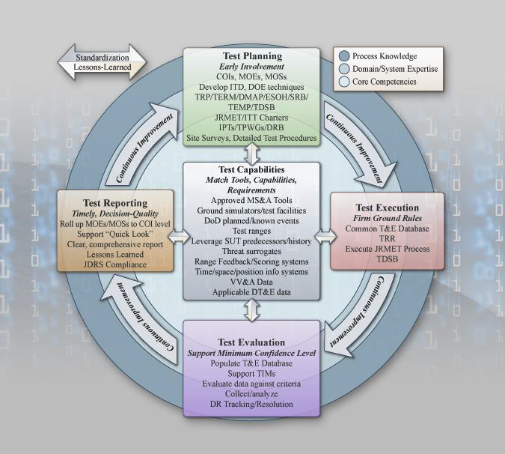
TEST AND EVALUATION
Test support that is ready before the test begins
Training subsystem requirements. Identify development and acquisition training subsystem requirements and specifications, perform technical assessments, develop test support requirements and documentation, and document cost and effectiveness estimates.
Capability test support. Technical support to Initial Operational Test and Evaluation (IOT&E), Limited User Test (LUT) and Developmental Test (DT).
Test document SME. Development and quality assurance of the Training Test Support Package (TTSP), Operational Test Readiness Statement Training (OTRS-T) and Test Training Certification Plan (TTCP); participation in IPTs, Process Action Teams and Operational Test Readiness Reviews.
Deficiency documentation. Deficiencies and discrepancies found in the TEMP, TTSP and TTCP documented and resolved with technical support during operational tests.
Joint interoperability testing. Expertise that improves policy development through formal, structured recommendations for decision makers.
SME for the documents that certify a system is ready for test: TTSP, OTRS-T and TTCP.
12
502 N. Garden Avenue, Suite M4a, Sierra Vista, AZ 85635 | www.isc-cg.com

Slide 14
SYSTEMS ENGINEERING AND INTEGRATION
Engineering discipline, concept through sustainment
Management and Professional Services
Studies, Analyses and Evaluations
Systems Acquisition
Mission performance and effectiveness analysis
Operational procedures definition
Engineering and technical services
Mission planning tool development
Airpower and space integration assessments
Acquisition gateway and milestone documentation
RFP preparation, schedule and risk management
Data and configuration management
Acquisition logistics and rapid acquisition support
Requirements definition
Program Objective Memorandum development
JCIDS support
Intimate knowledge of CJCSI 3170.01 and DoDI 5000.02. Experience spans full program lifecycles, with tailored processes and tools that produce repeatable, verifiable and reliable products.
13
502 N. Garden Avenue, Suite M4a, Sierra Vista, AZ 85635 | www.isc-cg.com

Slide 15
DISCRIMINATORS
Why customers choose ISC
1
Proven small business prime
2
Expertise with process discipline
Established program, quality and risk management processes. Exceptional performance demonstrated through CPARs and repeat customers.
Systems engineering and operational discipline applied by domain experts from system developers, government and academia, spanning requirements, acquisition, test and operations.
3
Thought leadership, no conflicts
4
People who stay
Innovative solutions delivered primarily through SE&I, SETA and A&AS contracts. OCI free and unbiased.
Small business culture, exceptional benefits, a highly qualified and motivated workforce, and industry high retention rates.
14
502 N. Garden Avenue, Suite M4a, Sierra Vista, AZ 85635 | www.isc-cg.com

Slide 16
SUMMARY
Experienced Prime Contractor
Twenty years of mission delivery for federal and Department of War customers, from concept to capability.
20-year heritage rooted in customer excellence and mission success.
Domain expertise across ISR, information technology, cyberspace, test and evaluation, systems engineering and integration, instructional solutions and artificial intelligence.
Technical services and support to Government customers, with exceptional technical, operational and programmatic qualifications and performance.
Process discipline that turns domain expertise into performance excellence.
Proven ability to hire and retain staff with specific domain expertise.
Experienced GSA Provider
Clint Imholte
Chief Executive Officer
520-678-8778 | Clint.imholte33@isc-cg.com
Danielle Downing
Senior Vice President
520-255-0968 | Danielle.downing@isc-cg.com
14
502 N. Garden Avenue, Suite M4a, Sierra Vista, AZ 85635 | www.isc-cg.com

